Slide 1
28/4/25

Slide 2
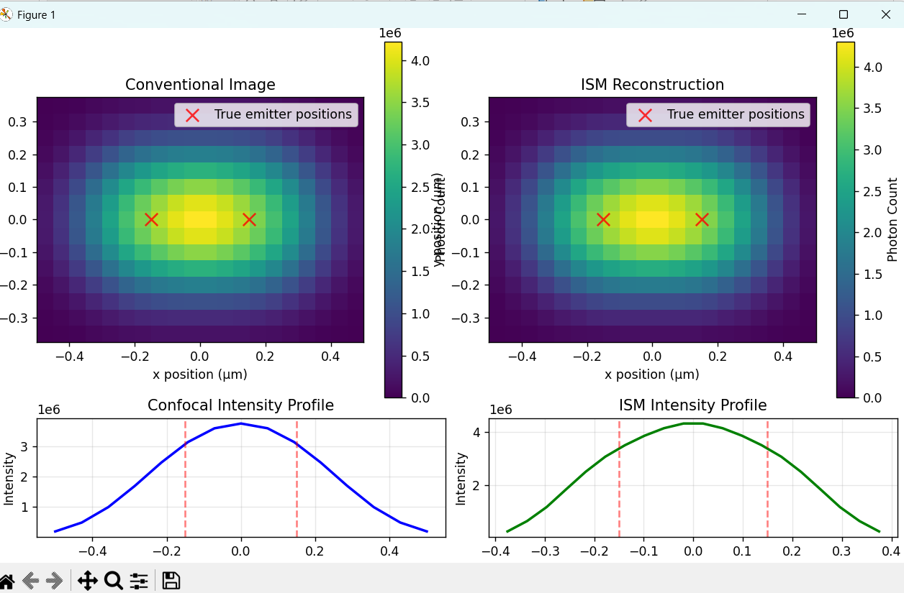

Slide 3
ISM

Slide 4
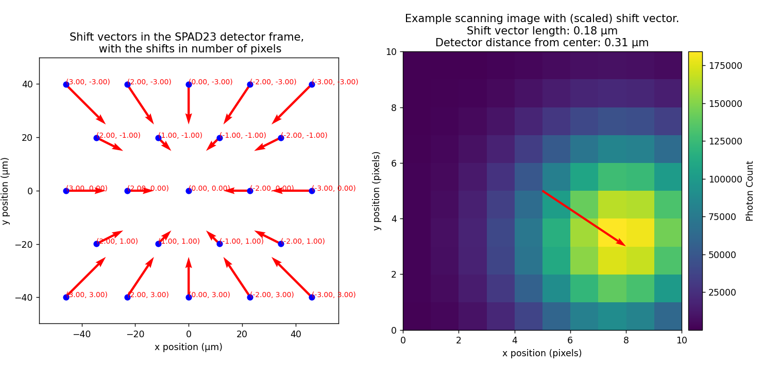
Shift vectors

Slide 5
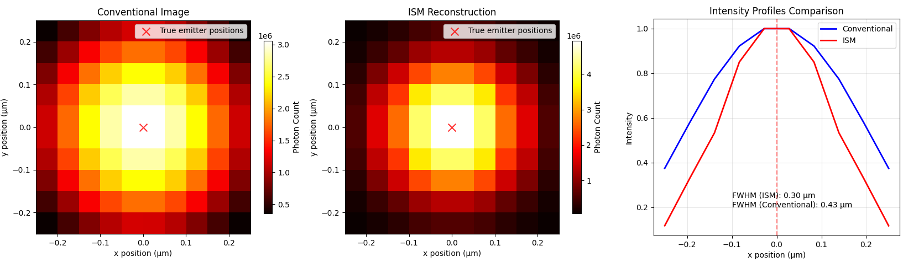

Slide 6
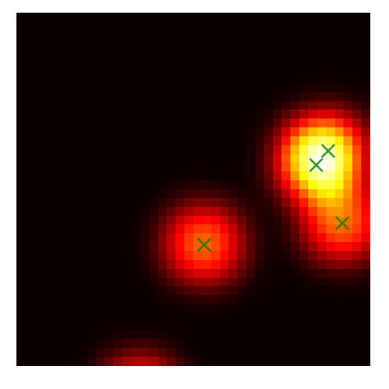
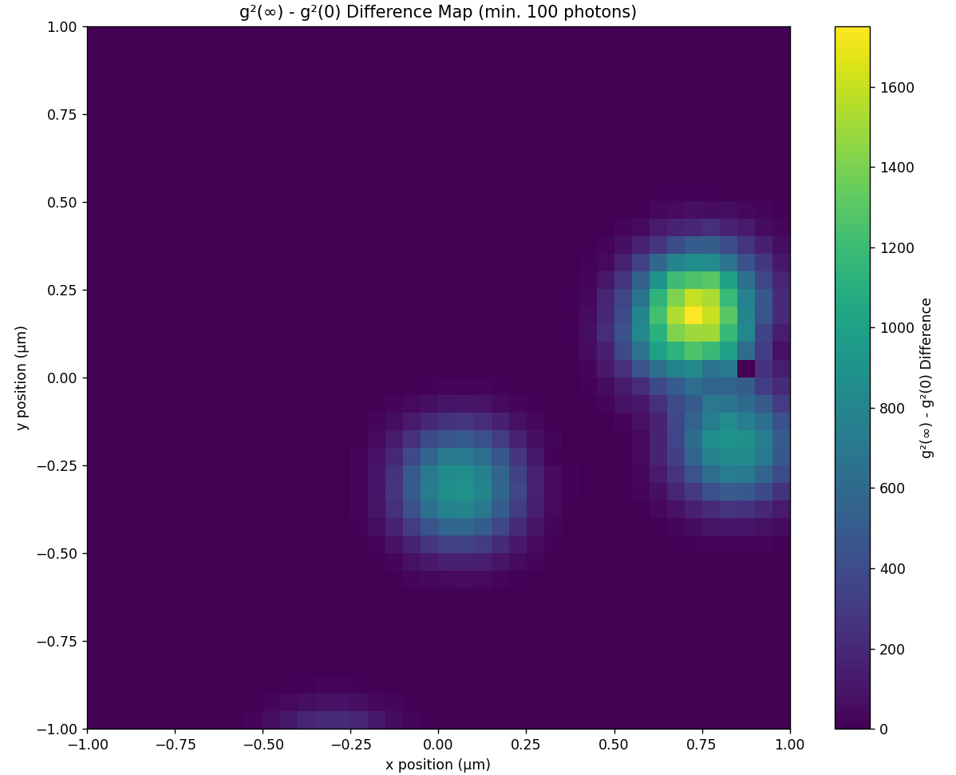

Intensity (left) and $\left\langle G^{2}\left(∞\right)\right\rangle −G^{2}(0)$ (right)

Slide 7
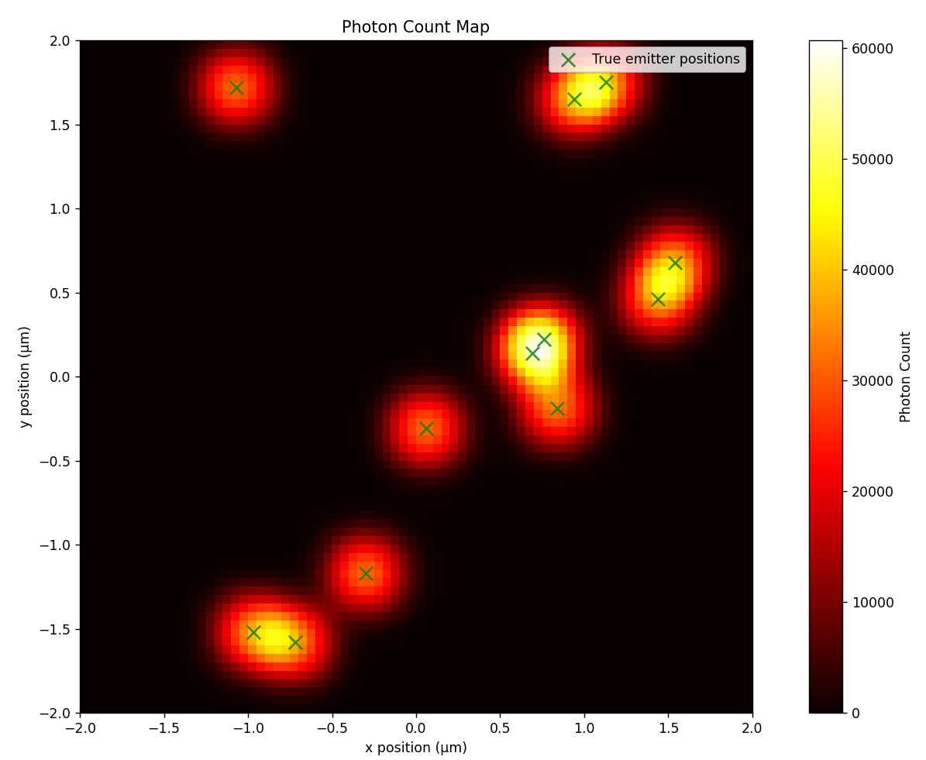
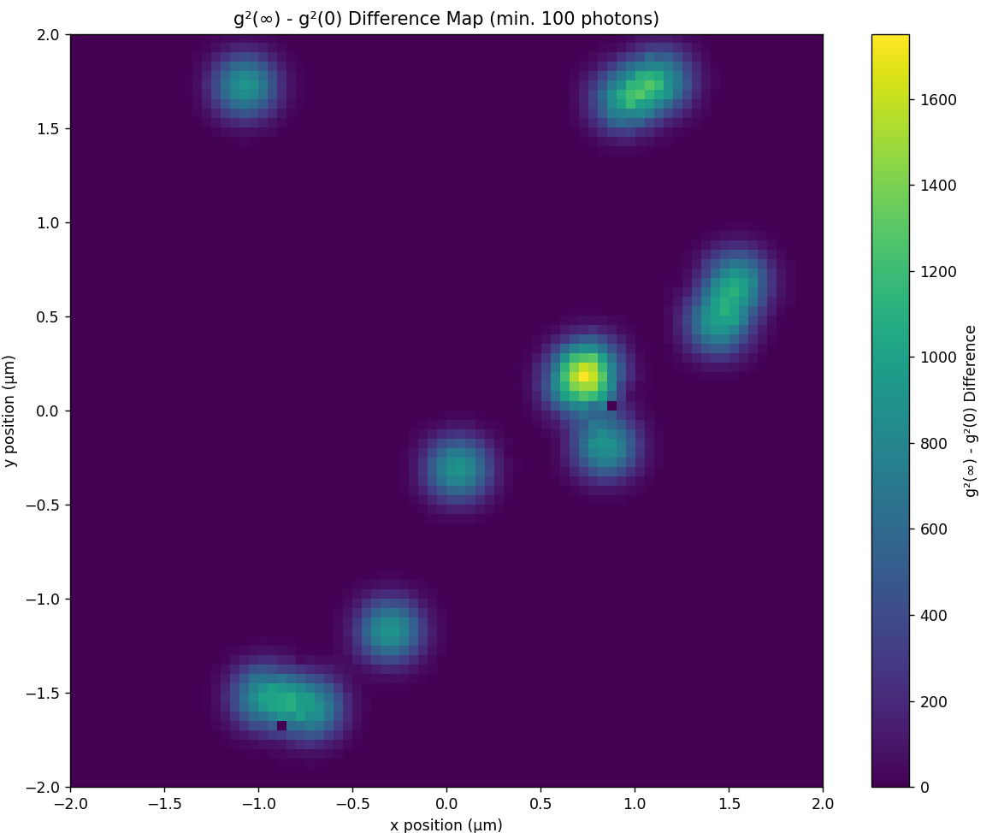

Slide 8
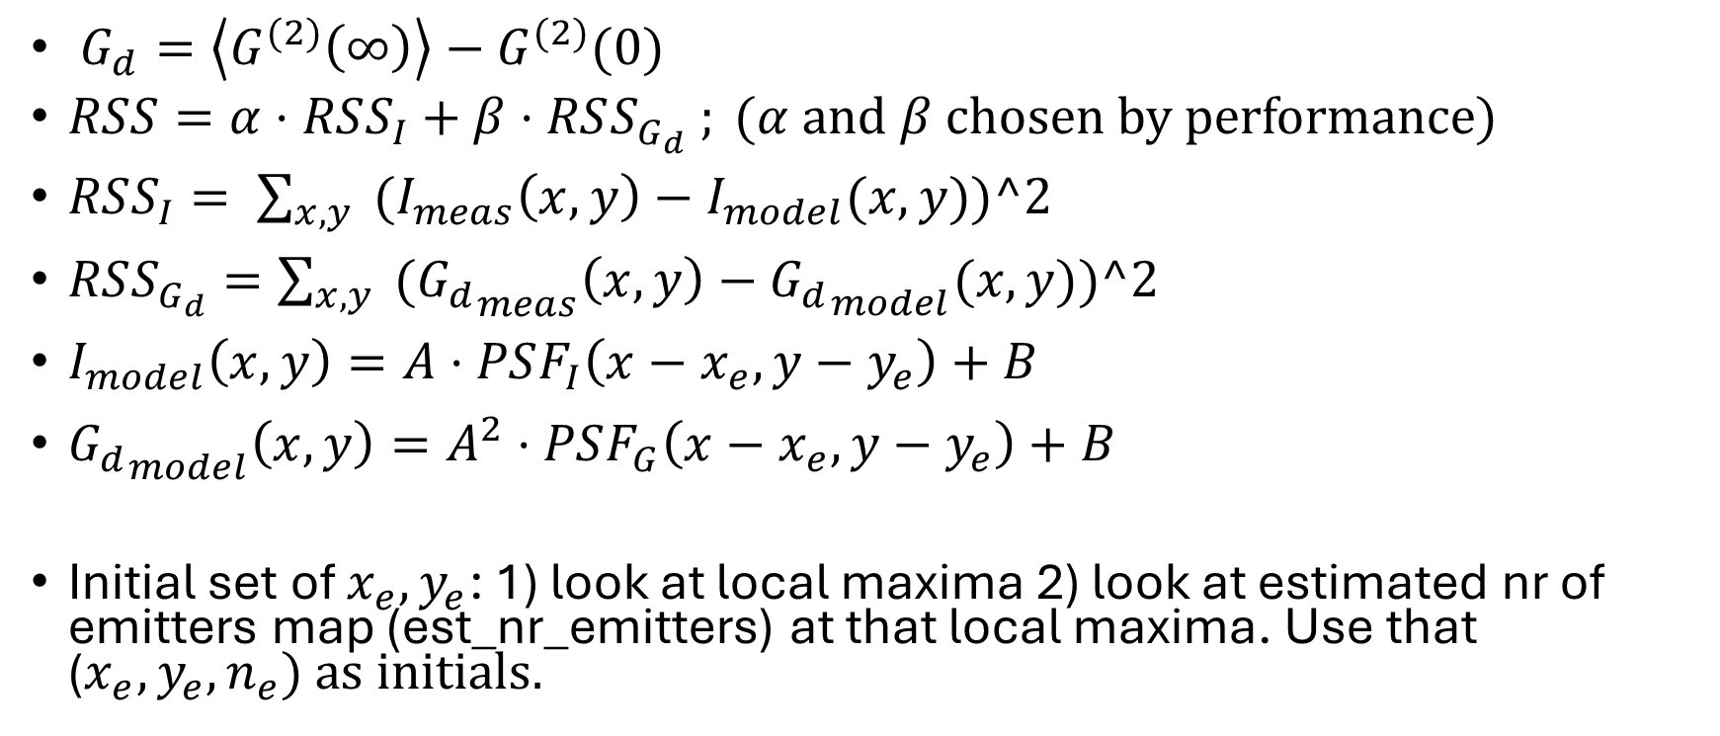
Approach 1: RSS (residual sum of squares)
$G_{d}=\left\langle G^{(2)}\left(∞\right)\right\rangle −G^{(2)}(0)$
$RSS=α⋅RSS_{I}+β⋅RSS_{G_{d}} ; (α$ and $β$ chosen by performance)
$RSS_{I}= \sum_{x,y}{{ (I}_{meas}\left(x,y\right)−I_{model}(x,y))^2}$
$RSS_{G_{d}}=\sum_{x,y}{{ (G_{d}}_{meas}\left(x,y\right)−{G_{d}}_{model}(x,y))^2}$
$I_{model}\left(x,y\right)=A⋅PSF_{I}\left(x−x_{e}, y−y_{e}\right)+B$
${G_{d}}_{model}\left(x,y\right)=A^{2}⋅PSF_{G}\left(x−x_{e}, y−y_{e}\right)+B$
Initial set of $x_{e}, y_{e}$: 1) look at local maxima 2) look at estimated nr of emitters map (est_nr_emitters) at that local maxima. Use that ($x_{e}, y_{e}, n_{e}) as initials.$

Slide 9
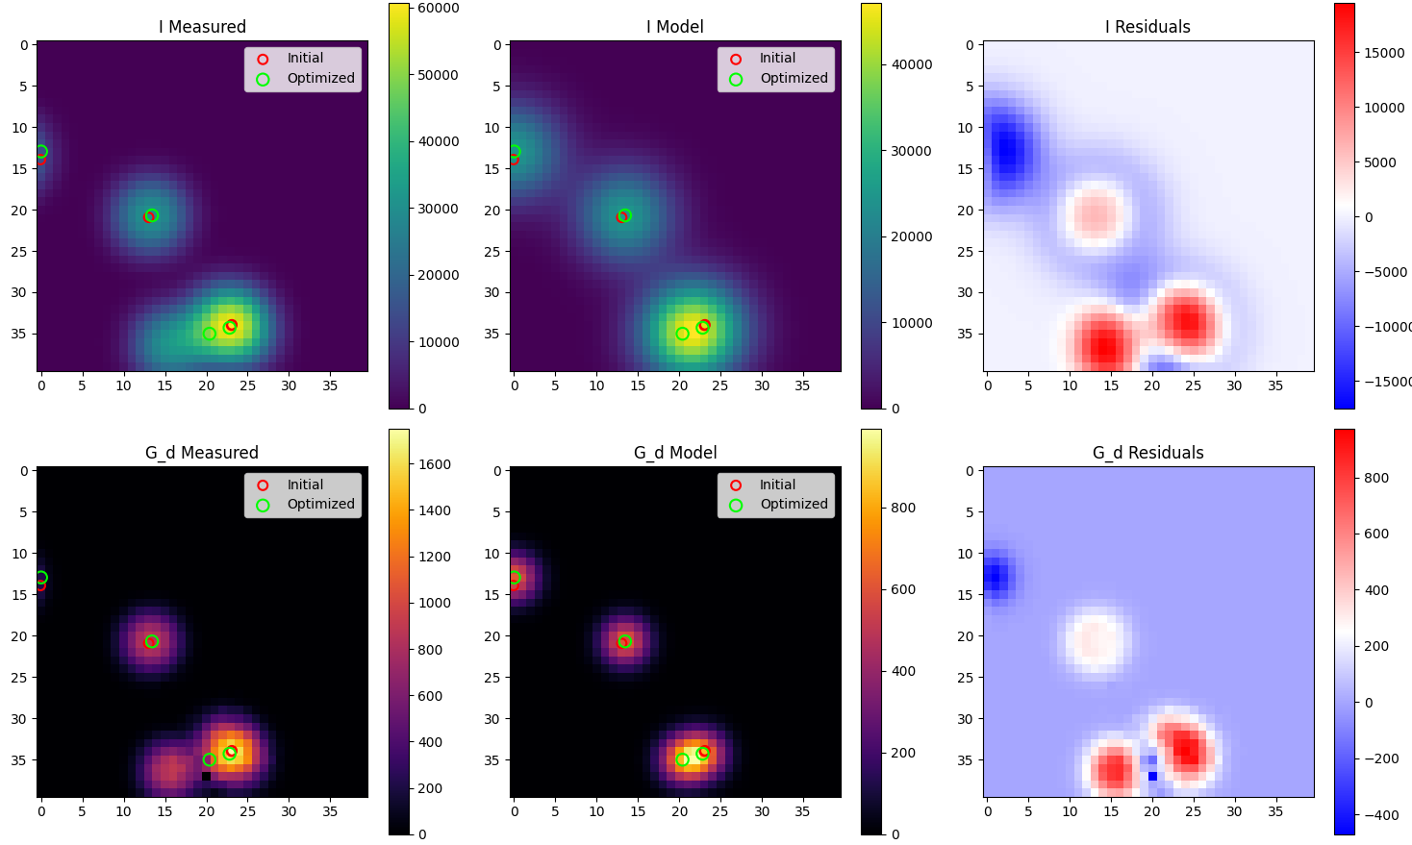

Slide 10
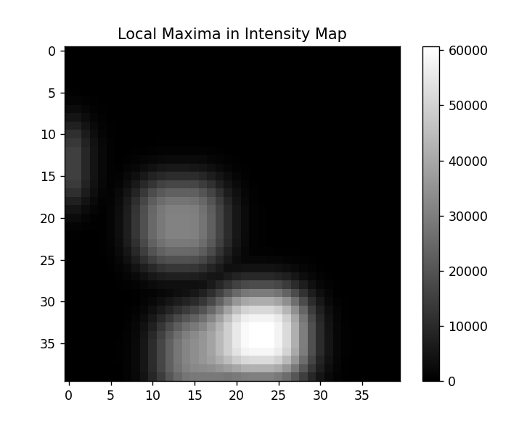
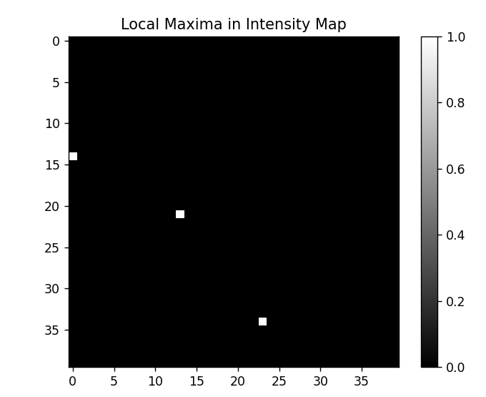
Initial positions
Find local maxima using pre-made algorithm
Iterate over each position; look in 5x5 neighbourhood; assign max value to that position. Then take only the intensity image where measured intensity is equal to local max map ; this gives the maxima

